Slide 1

Lesson 01 Programmable Logic Controllers and Ladder Logic Programming
Dr. David J. Coe
Electrical and Computer Engineering Department
University of Alabama in Huntsville
coed@uah.edu

Slide 2
Outline
Introduction to PLCs
Ladder Logic Programming
OpenPLC Editor
Suggested Reading
Hands-On Laboratory Exercise #1

Slide 3
Introduction to PLCs

Slide 4
Programmable Logic Controllers (PLCs)
Programmable Logic Controller (PLC)
An embedded computing platform that uses sensors to perceive the state of the physical system and actuators to modify that state according to a control algorithm

Slide 5
Overview PLC Operation - 1
Physical Inputs
Step 1
At the beginning of the cycle, the PLC perceives the state of the physical system by reading the physical inputs and storing those values in the input table
Comments
Physical inputs may change before current cycle is complete
Cycle time is chosen such that the amount of input change will be negligible before beginning of next cycle
Input Table
Control Algorithm
PLC
Output Table
Physical Outputs

Slide 6
Overview PLC Operation - 2
Physical Inputs
Input Table
Step 2
The control algorithm uses values from input table to compute the outputs which are stored in the output table
Control Algorithm
PLC
Output Table
Physical Outputs

Slide 7
Overview PLC Operation - 3
Physical Inputs
Input Table
Step 3
At the end of the cycle, the values from the output table are written to the physical outputs to exercise control over the system
Comments
At the beginning of the next cycle, the PLC will repeat this three-step sequence again starting with Step 1
Control Algorithm
PLC
Output Table
Physical Outputs

Slide 8
Cycle Time
Cycle time duration is driven by the physics of the physical system (and the computing capabilities of the PLC)
A system whose state changes very slowly over time can have a longer cycle time
Example: Electric water heater
Slow to empty, slow to reheat
A system whose state changes rapidly will require a much shorter cycle time so the PLC can maintain control of the physical system
Example: First stage of a liquid-fueled rocket
Rapid change in speed, altitude, and mass

Slide 9
Control Algorithm Representation
The OpenPLC platform is compatible with all five standard representations of control algorithm logic (as defined by IEC-61131-3) including
Ladder Logic (LD)
Structured Text (ST)
Instruction List (IL)
Function Block Diagram (FBD)
Sequential Function Chart (SFC)
The OpenPLC Editor converts all representations into Structured Text prior to compilation
Today we will focus on Ladder Logic
https://www.openplcproject.com/reference-what-is-a-plc

Slide 10
Ladder Logic Programming

Slide 11
What is Ladder Logic?
Ladder Logic
A graphical programming language derived from relay (ladder) logic
A relay is a switch operated by an actuator such as an electromagnet

Slide 12
Ladder Logic Structure
Ladder logic consists of a sequence of one or more ladder rungs
Each rung includes one or more contacts or function blocks and one or more coils along with rails
Rails are sources or sinks of electric current
Left rail is at a positive voltage (current source)
Right rail at ground (current sink)
Contacts may be inputs or computed intermediate values
Coils are outputs
A given rung is interpreted left-to-right as drawn
The rungs are processed in the order they appear in the ladder logic diagram top-to-bottom

Slide 13
Sample Ladder Logic Rung
Left Rail (+)
Right Rail (-)
Contact
Coil
( )
Push Button
Lamp

Slide 14
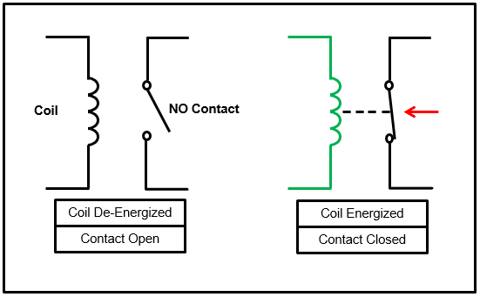
Ladder Logic Symbols - 1
Normally Open Contact (NO)
Mechanical spring holds A-B switch open
Energized electromagnet coil overpowers spring to close switch
Logic 1 (positive voltage) energizes electromagnet coil
Logic 0 (zero voltage) allows spring to dominate
A
A
Ladder Logic Symbol
B
B
No path for current to flow from A to B
Current may now flow from A to B
https://ladderlogicworld.com/relay-logic-vs-ladder-logic/

Slide 15
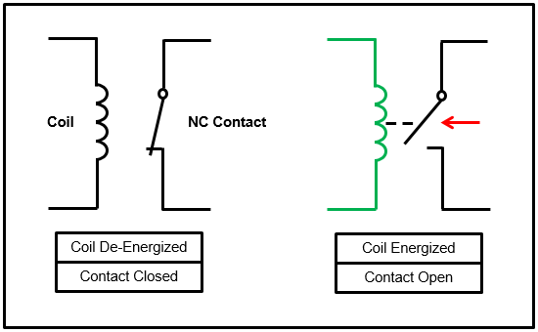
Ladder Logic Symbols - 2
Normally Closed Contact (NC)
Mechanical spring holds A-B switch closed
Energized electromagnet coil overpowers spring to open switch
Logic 1 (positive voltage) energizes electromagnet coil
Logic 0 (zero voltage) allows spring to dominate
A
A
Ladder Logic Symbol
B
B
Current may now flow from A to B
No path for current to flow from A to B
https://ladderlogicworld.com/relay-logic-vs-ladder-logic/

Slide 16
Ladder Logic Symbols - 3
Coil
An output or external load such as an actuator (motor, heater, etc.) or annunciator (bulb, LED, etc.)
Logic 1 (positive voltage) energizes coil
Logic 0 (zero voltage) de-energizes coil
( )
Ladder Logic Symbol

Slide 17
Ladder Logic Symbols - 4
Negated Coil
A output or external load such as an actuator (motor, heater, etc.) or annunciator (bulb, LED, etc.)
Logic 1 (positive voltage) de-energizes coil
Logic 0 (zero voltage) energizes coil
( )
Ladder Logic Symbol

Slide 18
Ladder Logic Symbols - 5
Function Blocks
Many different function blocks available
Timers
Adders
Multiplexers
Memory
Etc.

Slide 19
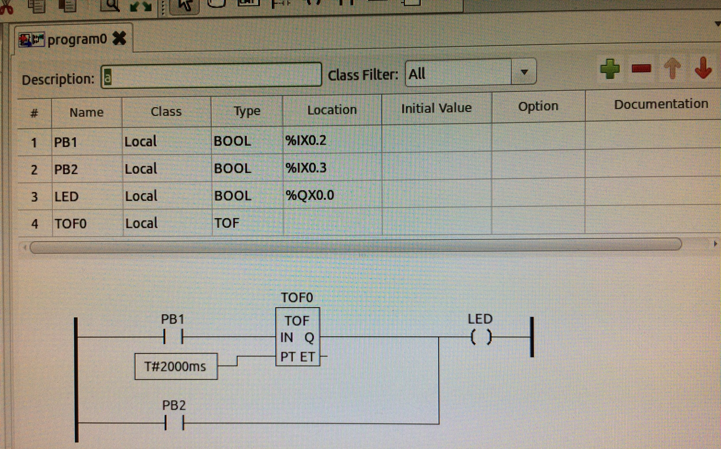
Sample Ladder Logic in OpenPLC Editor
Sample use of constant block and timer block

Slide 20
OpenPLC Editor

Slide 21
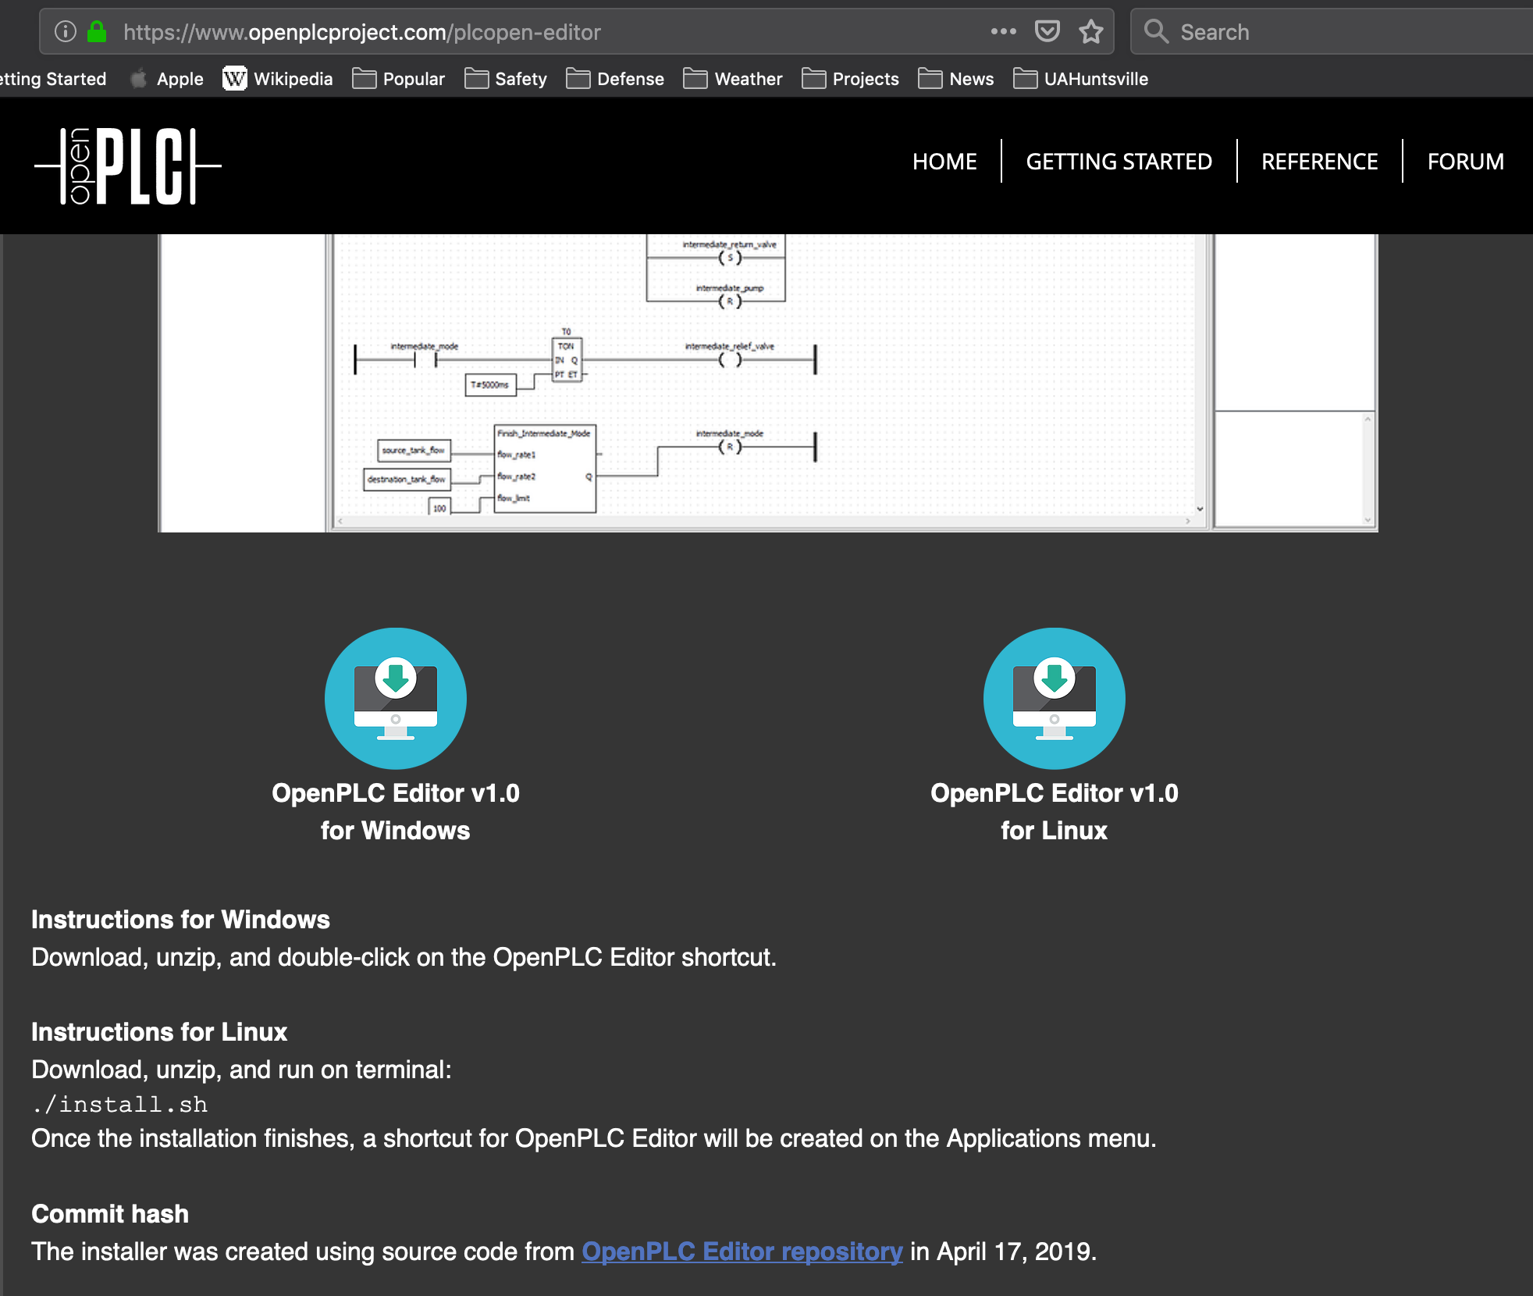
Install OpenPLC Editor
https://www.openplcproject.com/plcopen-editor

Slide 22
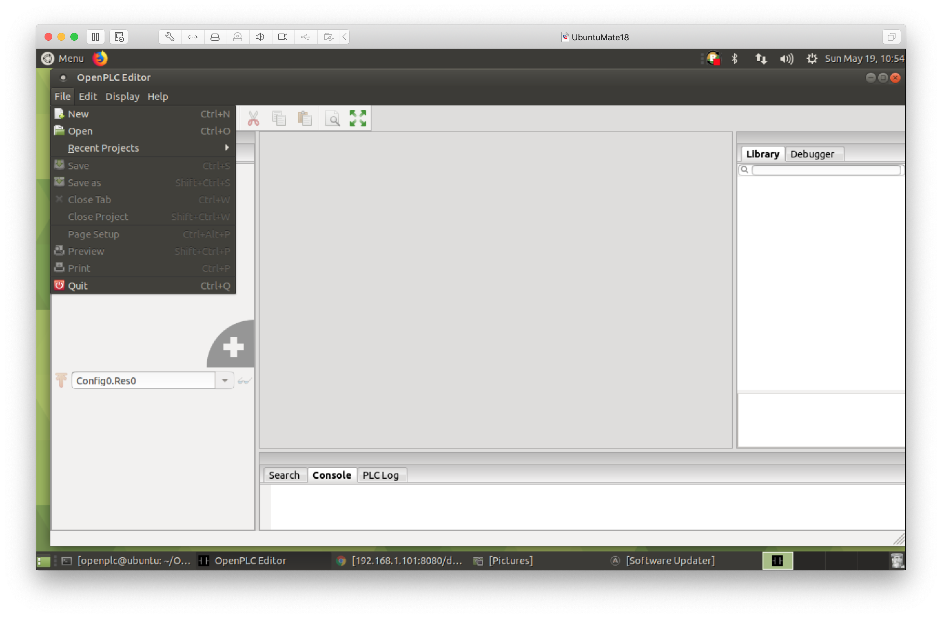
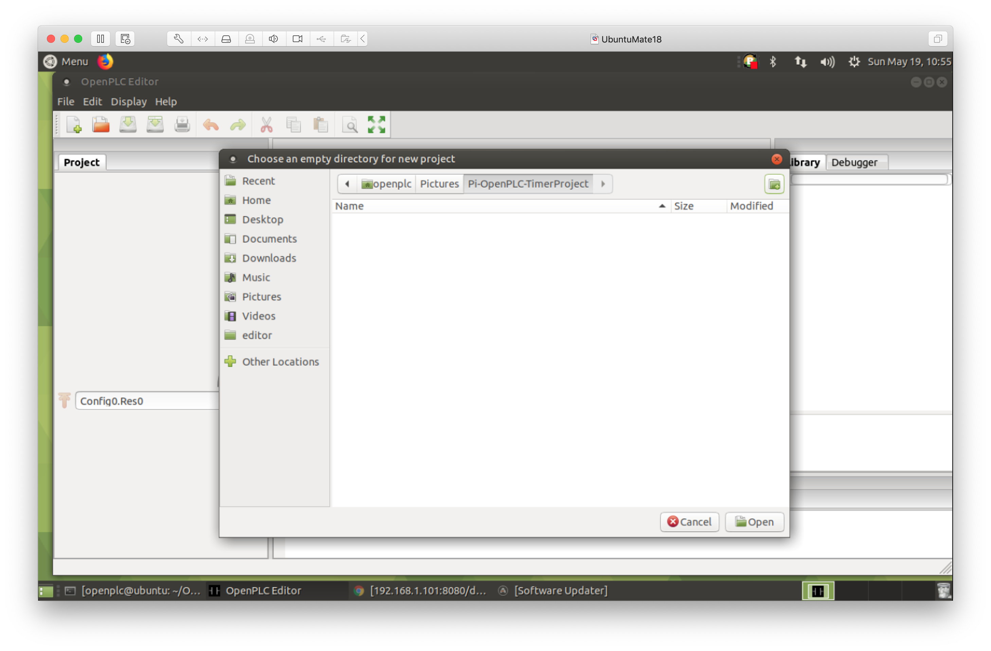
Enter Ladder Logic - 1
1. Create new project
2. Create new project folder

Slide 23
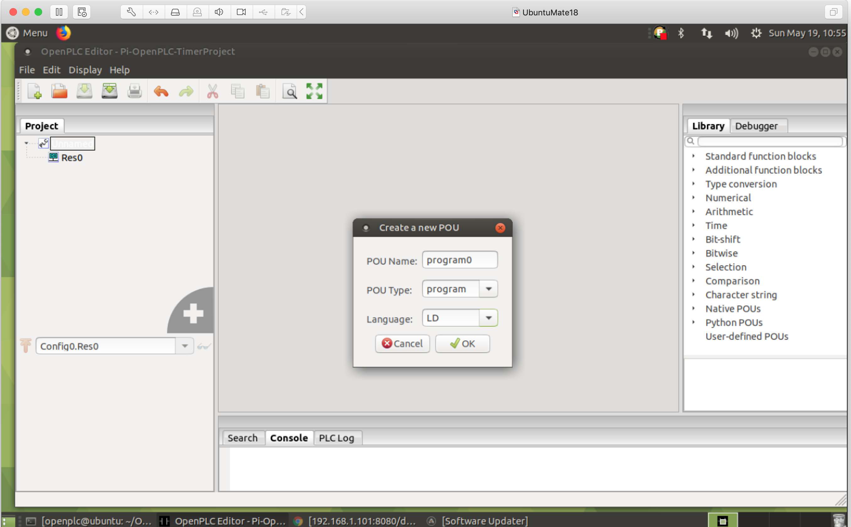
Enter Ladder Logic - 2
Select LD for a Ladder Logic program

Slide 24
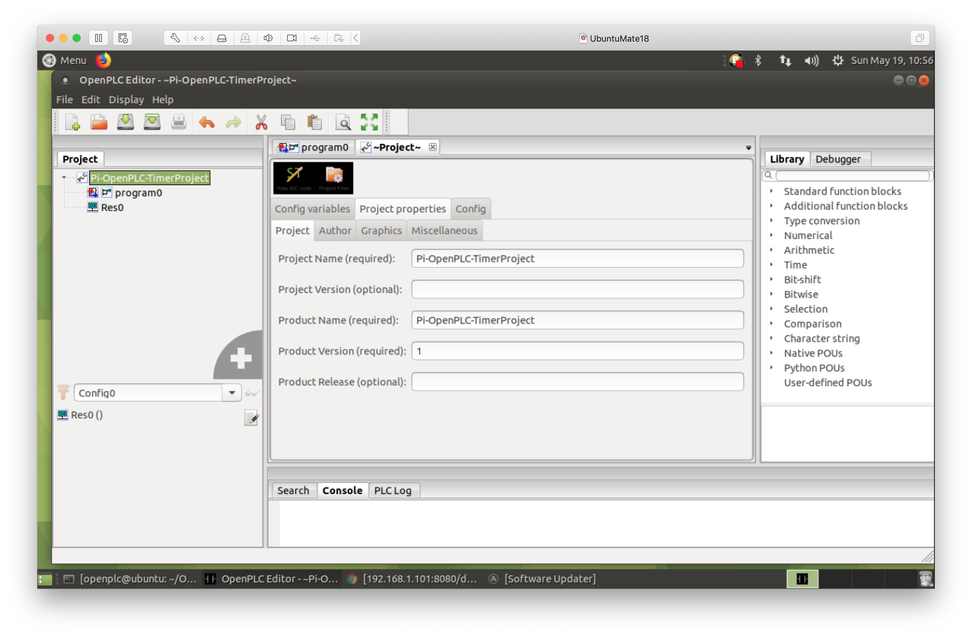
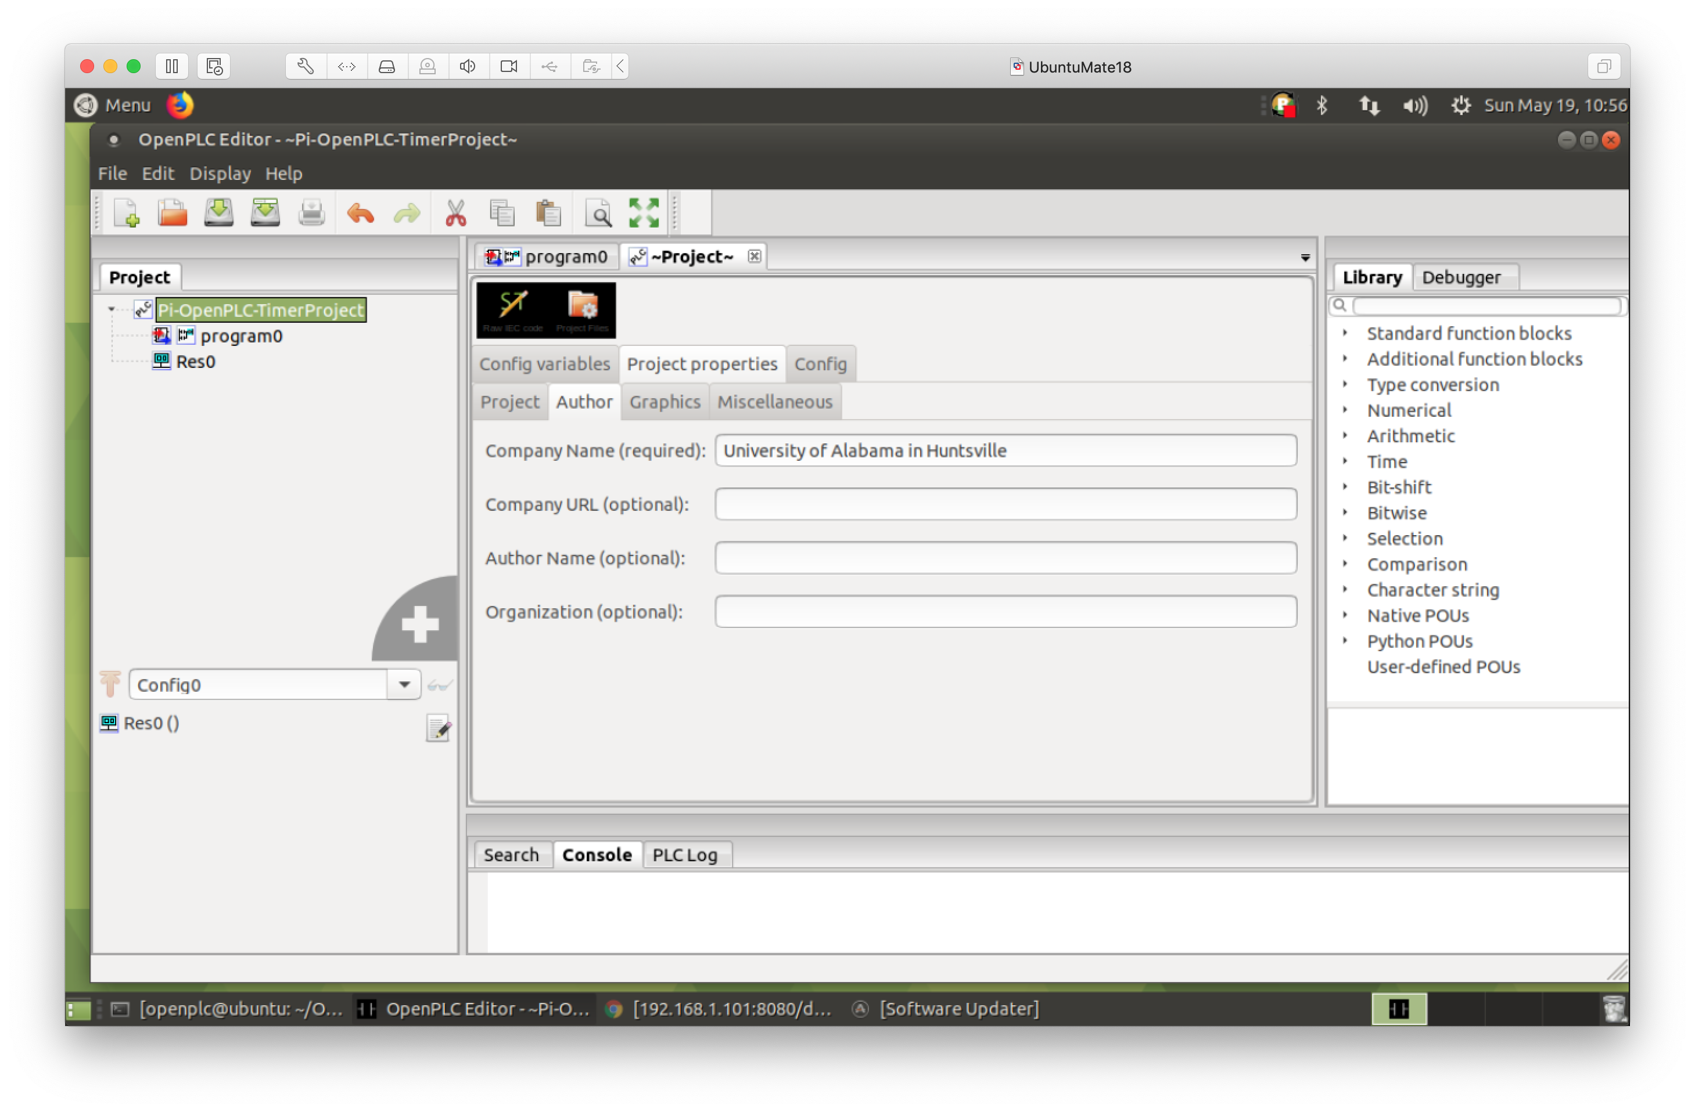
Enter Ladder Logic - 3
1. Set Project and Product names
2. Set Company name

Slide 25
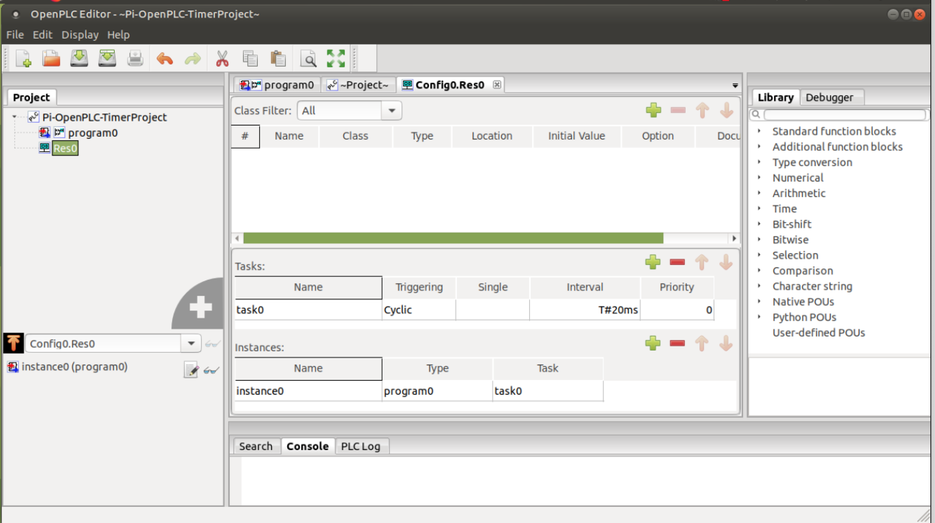
Enter Ladder Logic - 4
Verify default Task (task0) and Instance (instance0) created

Slide 26
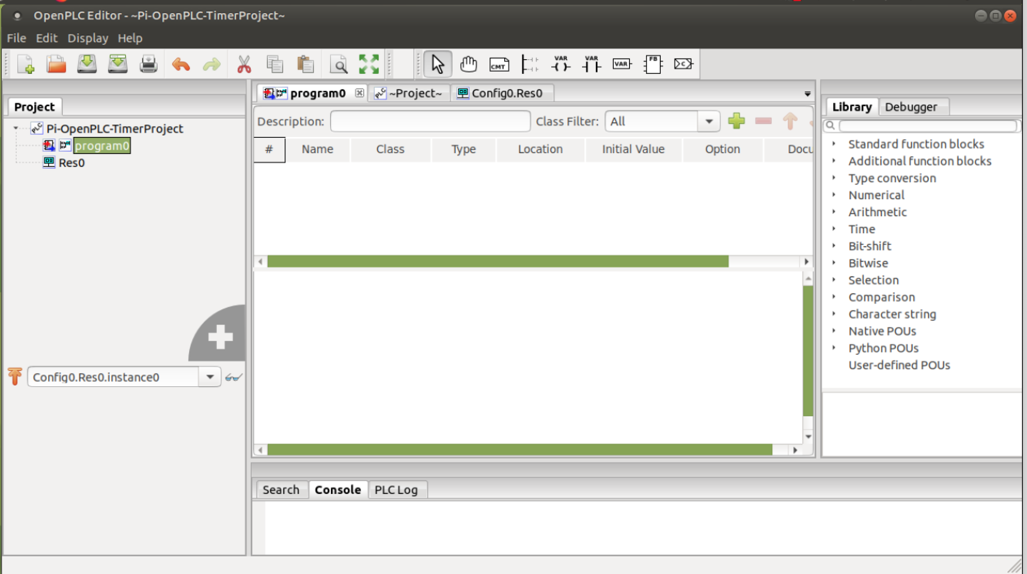
Enter Ladder Logic - 5
Ladder Logic Toolbar
Select program0 to see ladder logic editor

Slide 27
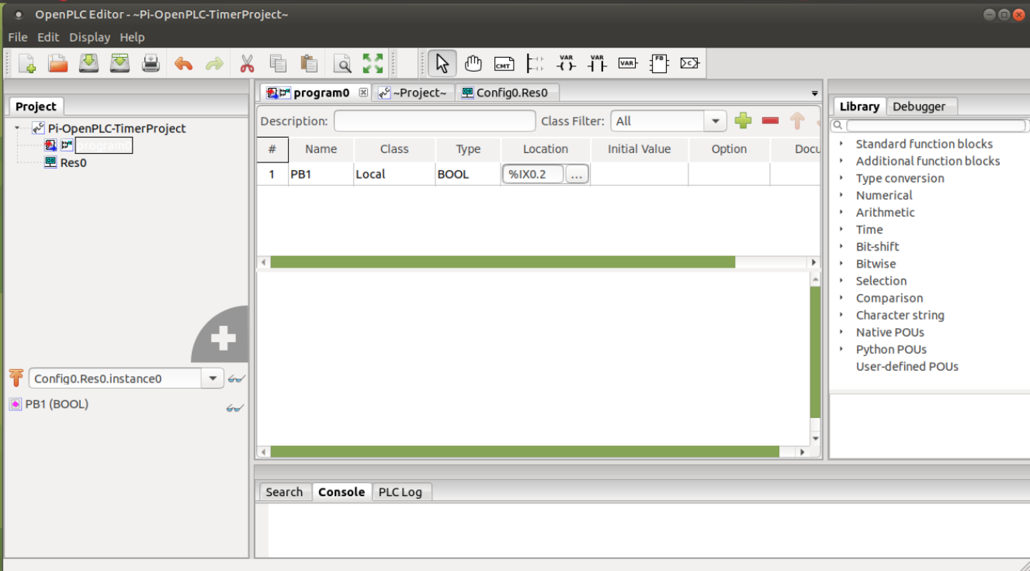
Enter Ladder Logic - 6
Hit green plus sign to add program variables
(Note: These are Raspberry Pi location values)

Slide 28
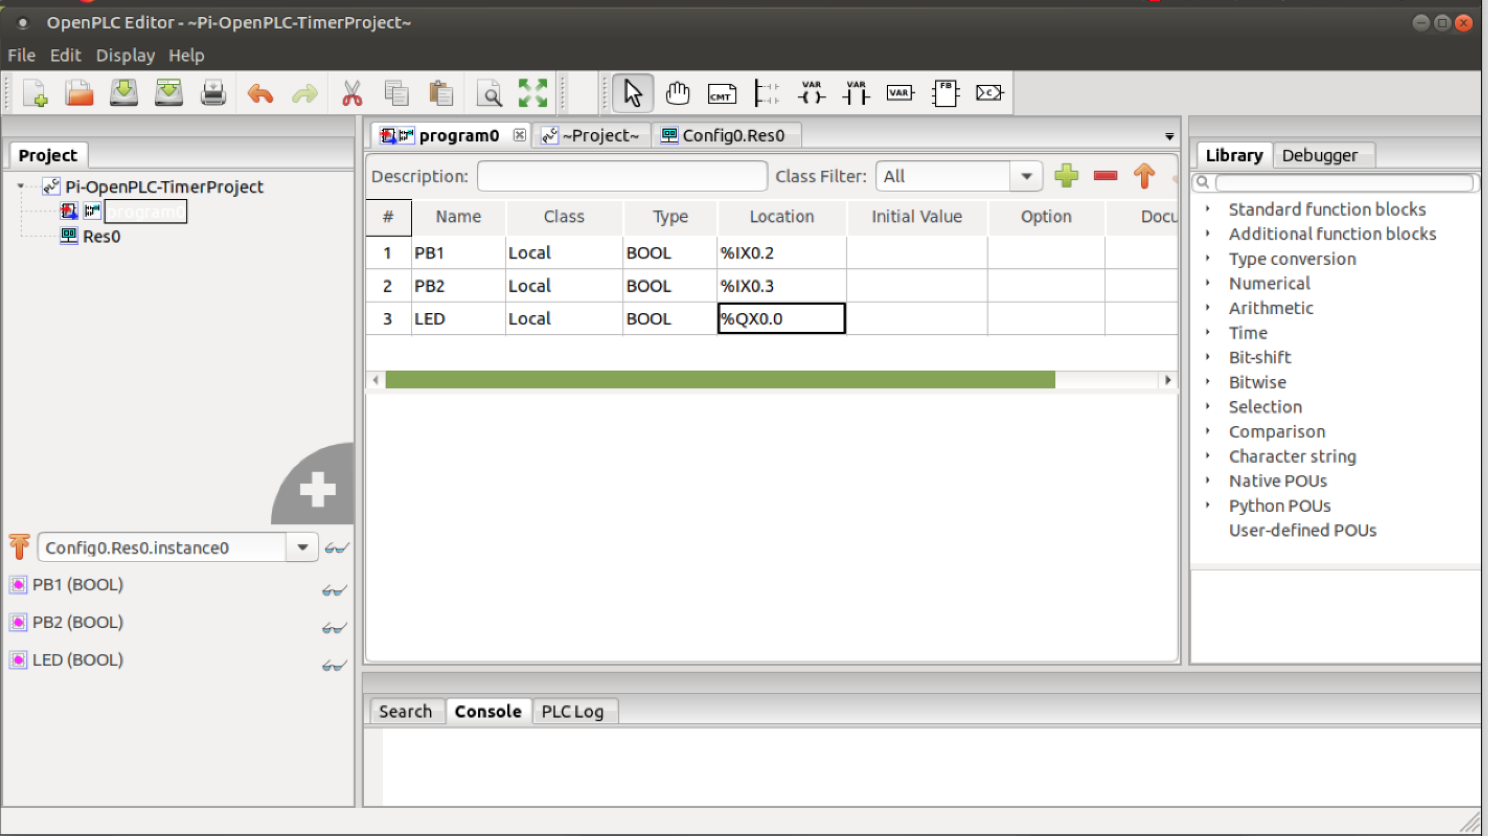
Enter Ladder Logic - 7
All variables created – locations correspond to physical hardware pins
%IX is an input
%QX is an output

Slide 29
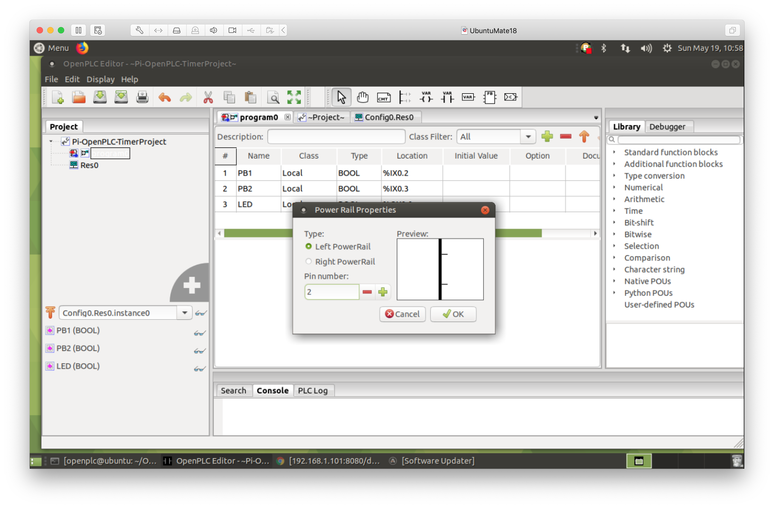
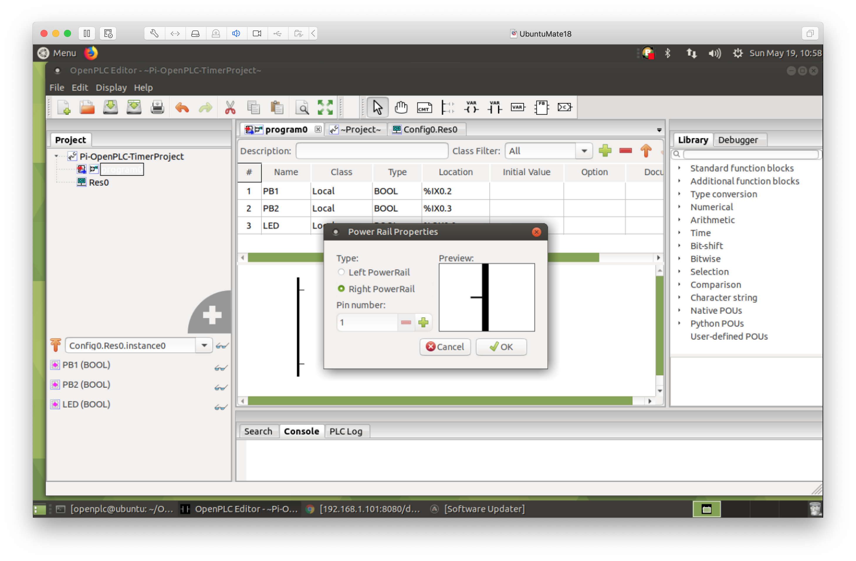
Enter Ladder Logic - 8
1. Create left rail with two pins
2. Create right rail with one pin

Slide 30
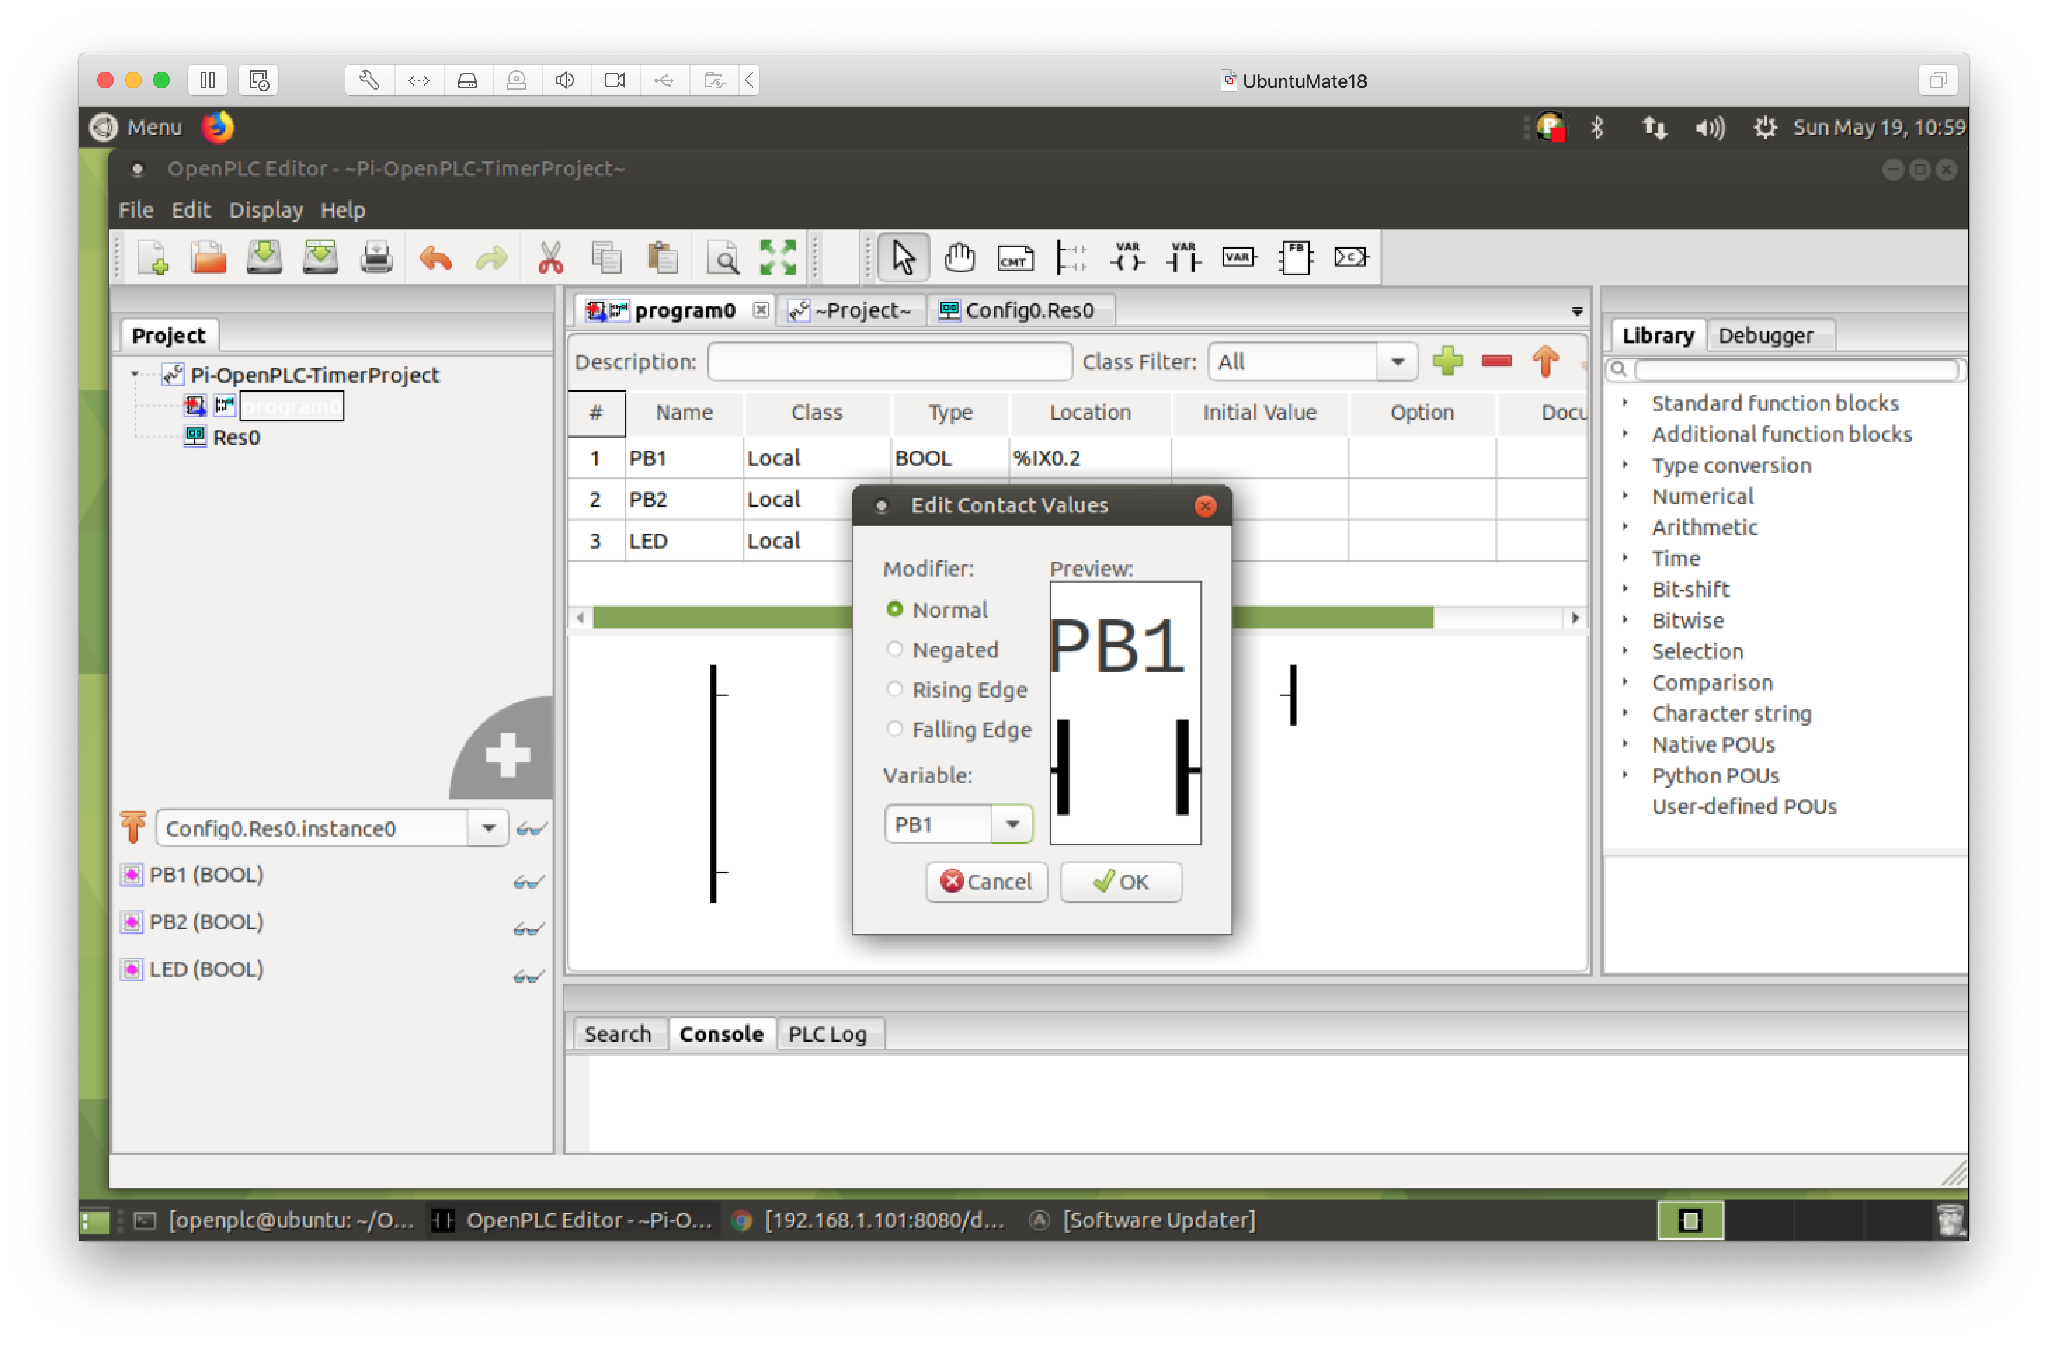
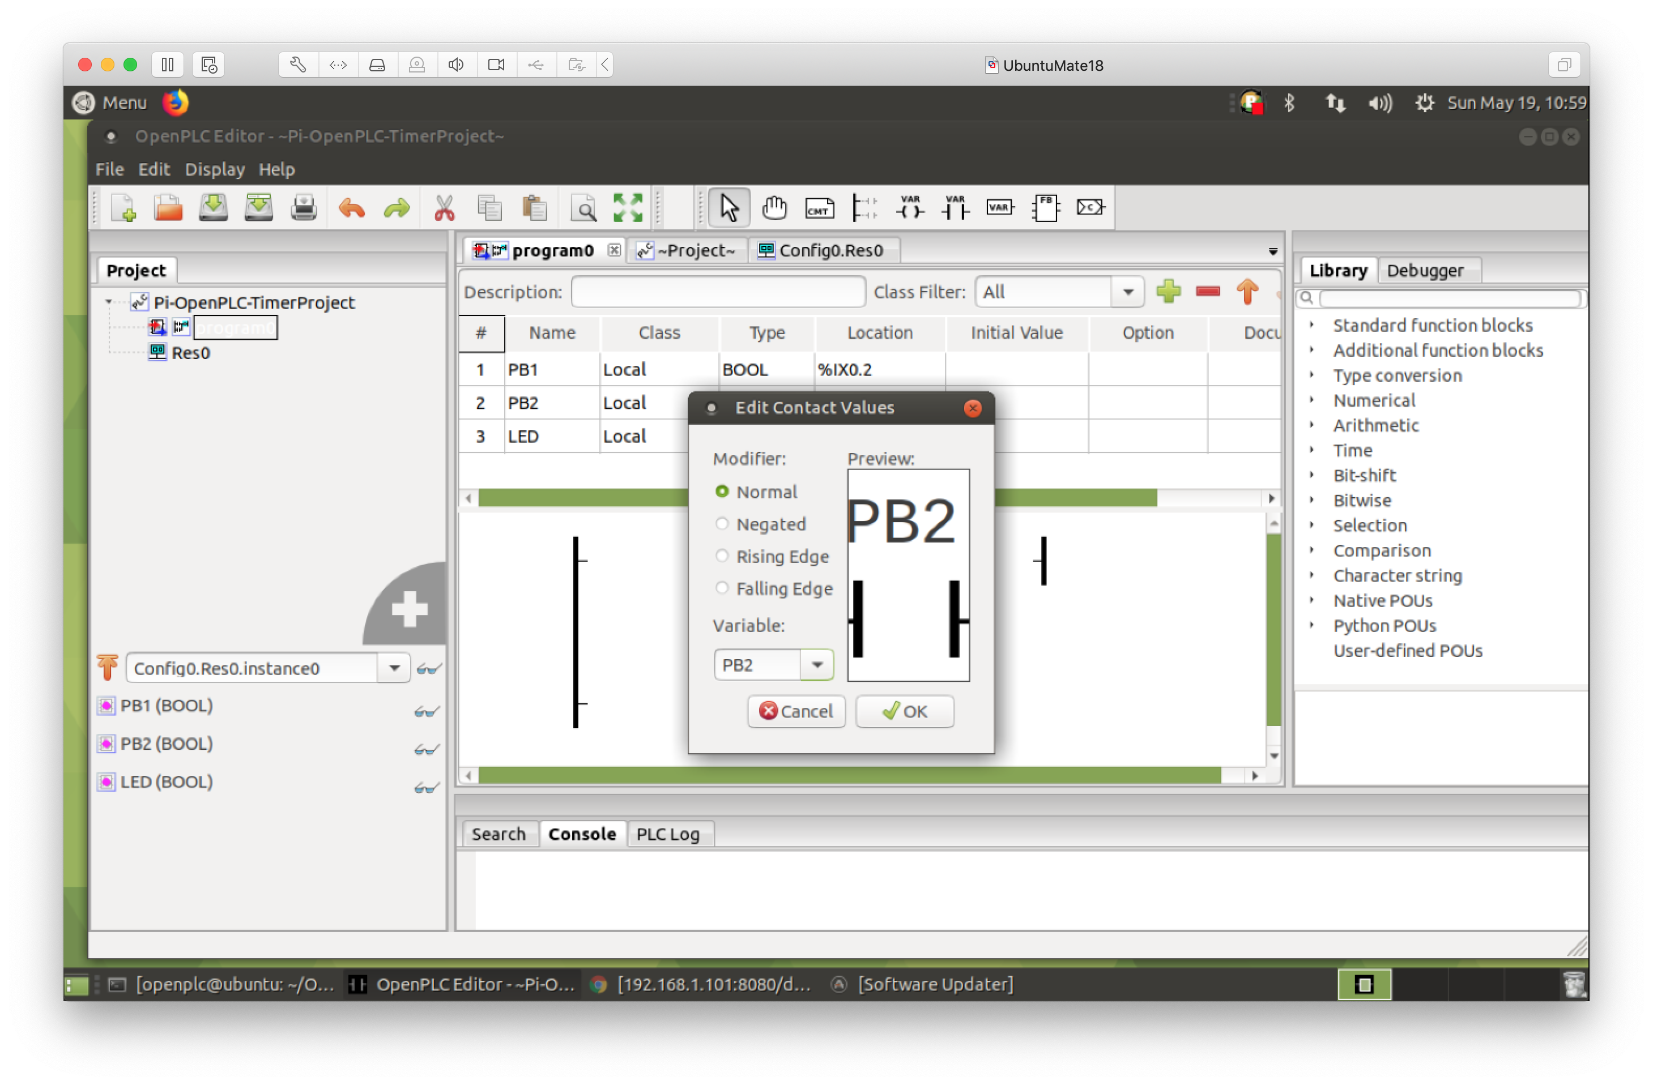
Enter Ladder Logic - 9
1. Create Push Button #1
2. Create Push Button #2

Slide 31
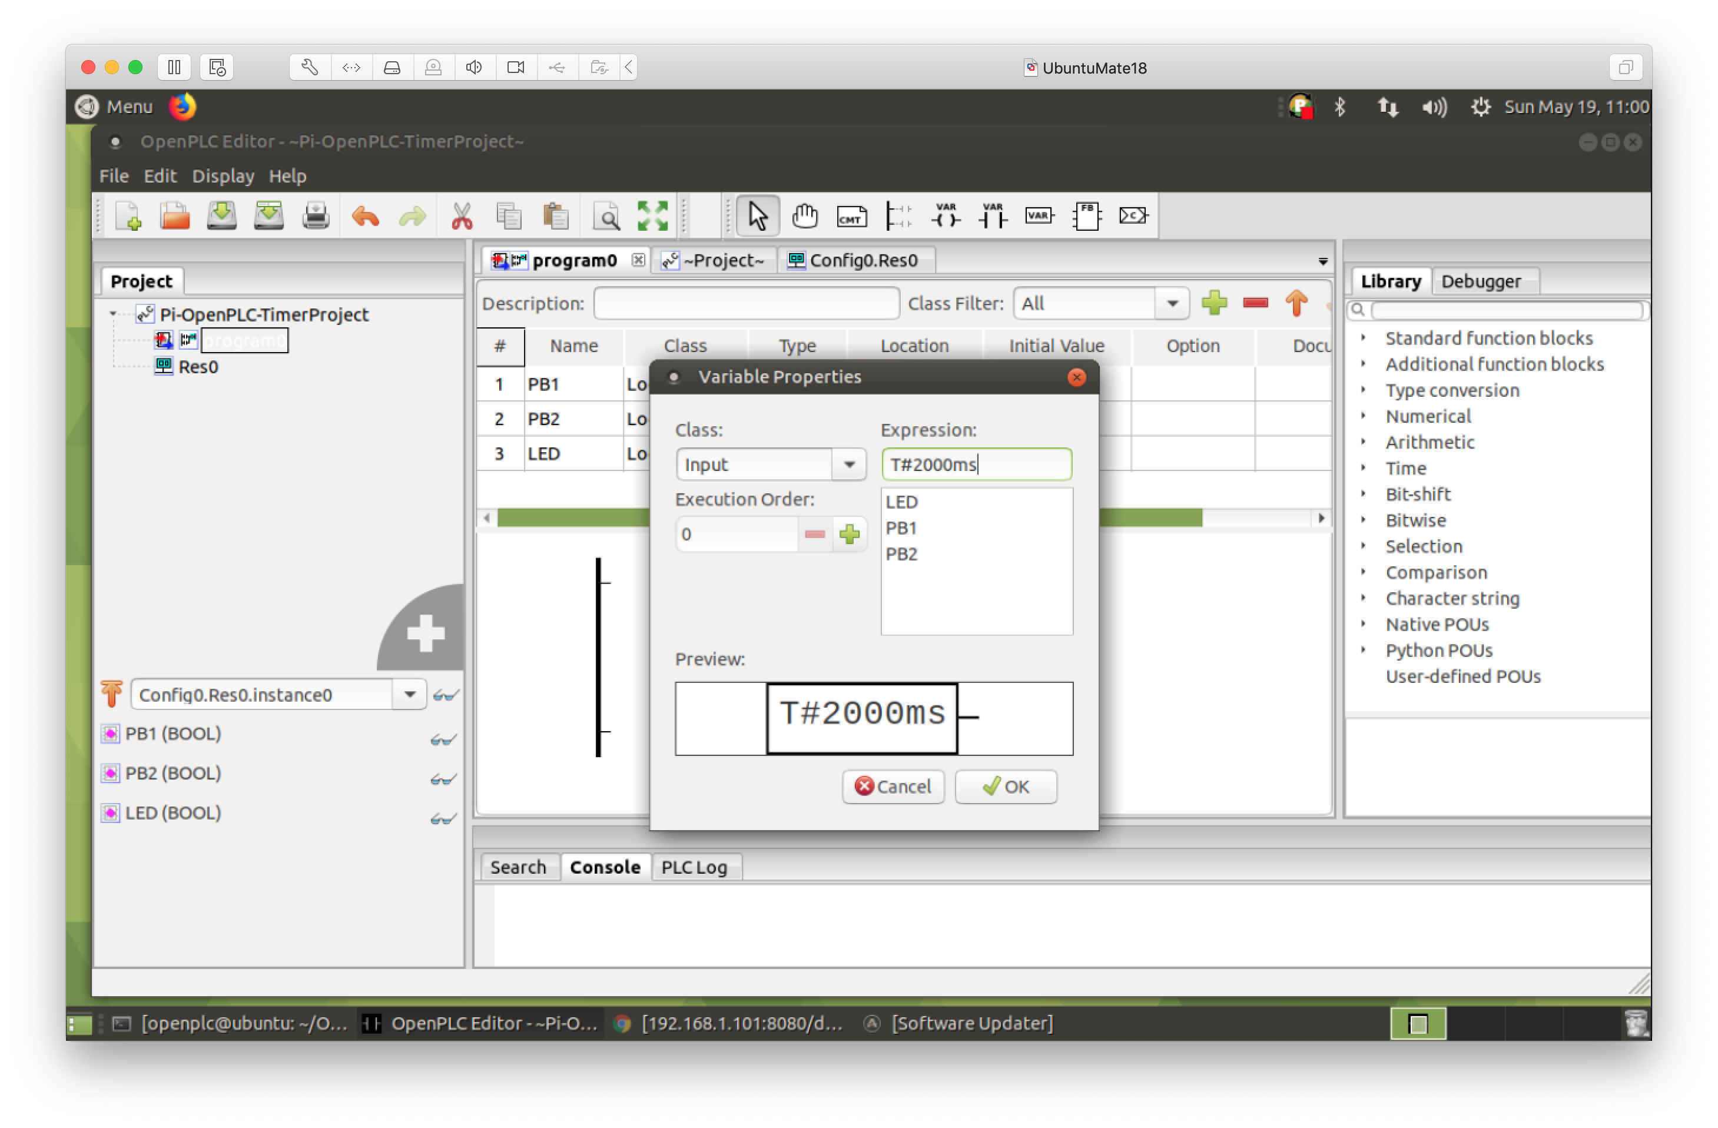
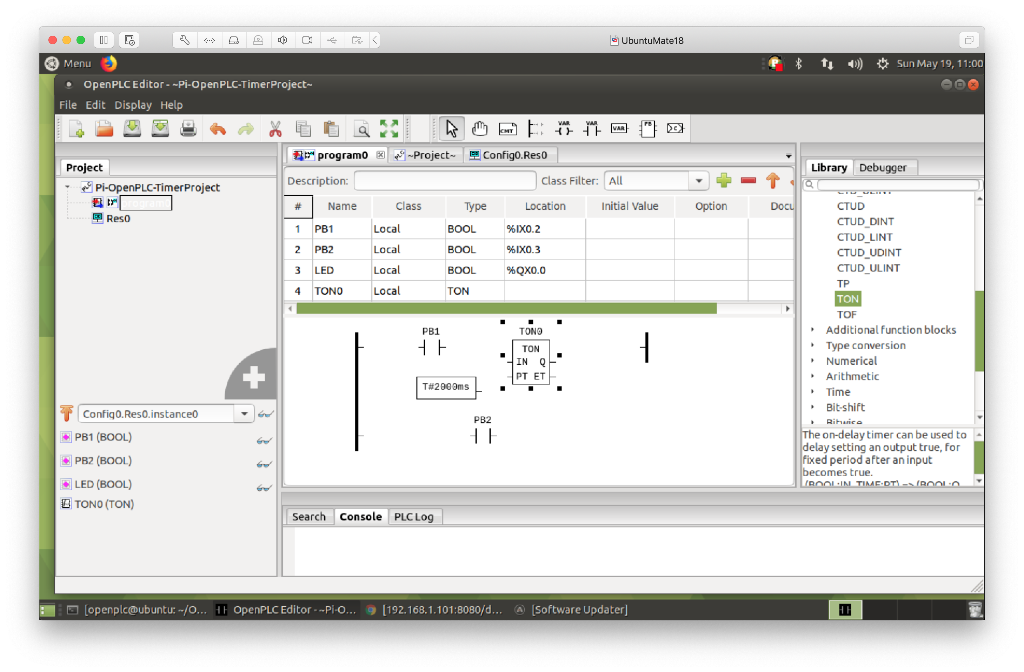
Enter Ladder Logic - 10
1. Create 2 second constant (2000 msec)
2. Drag and drop on-delay timer (TON) function block

Slide 32
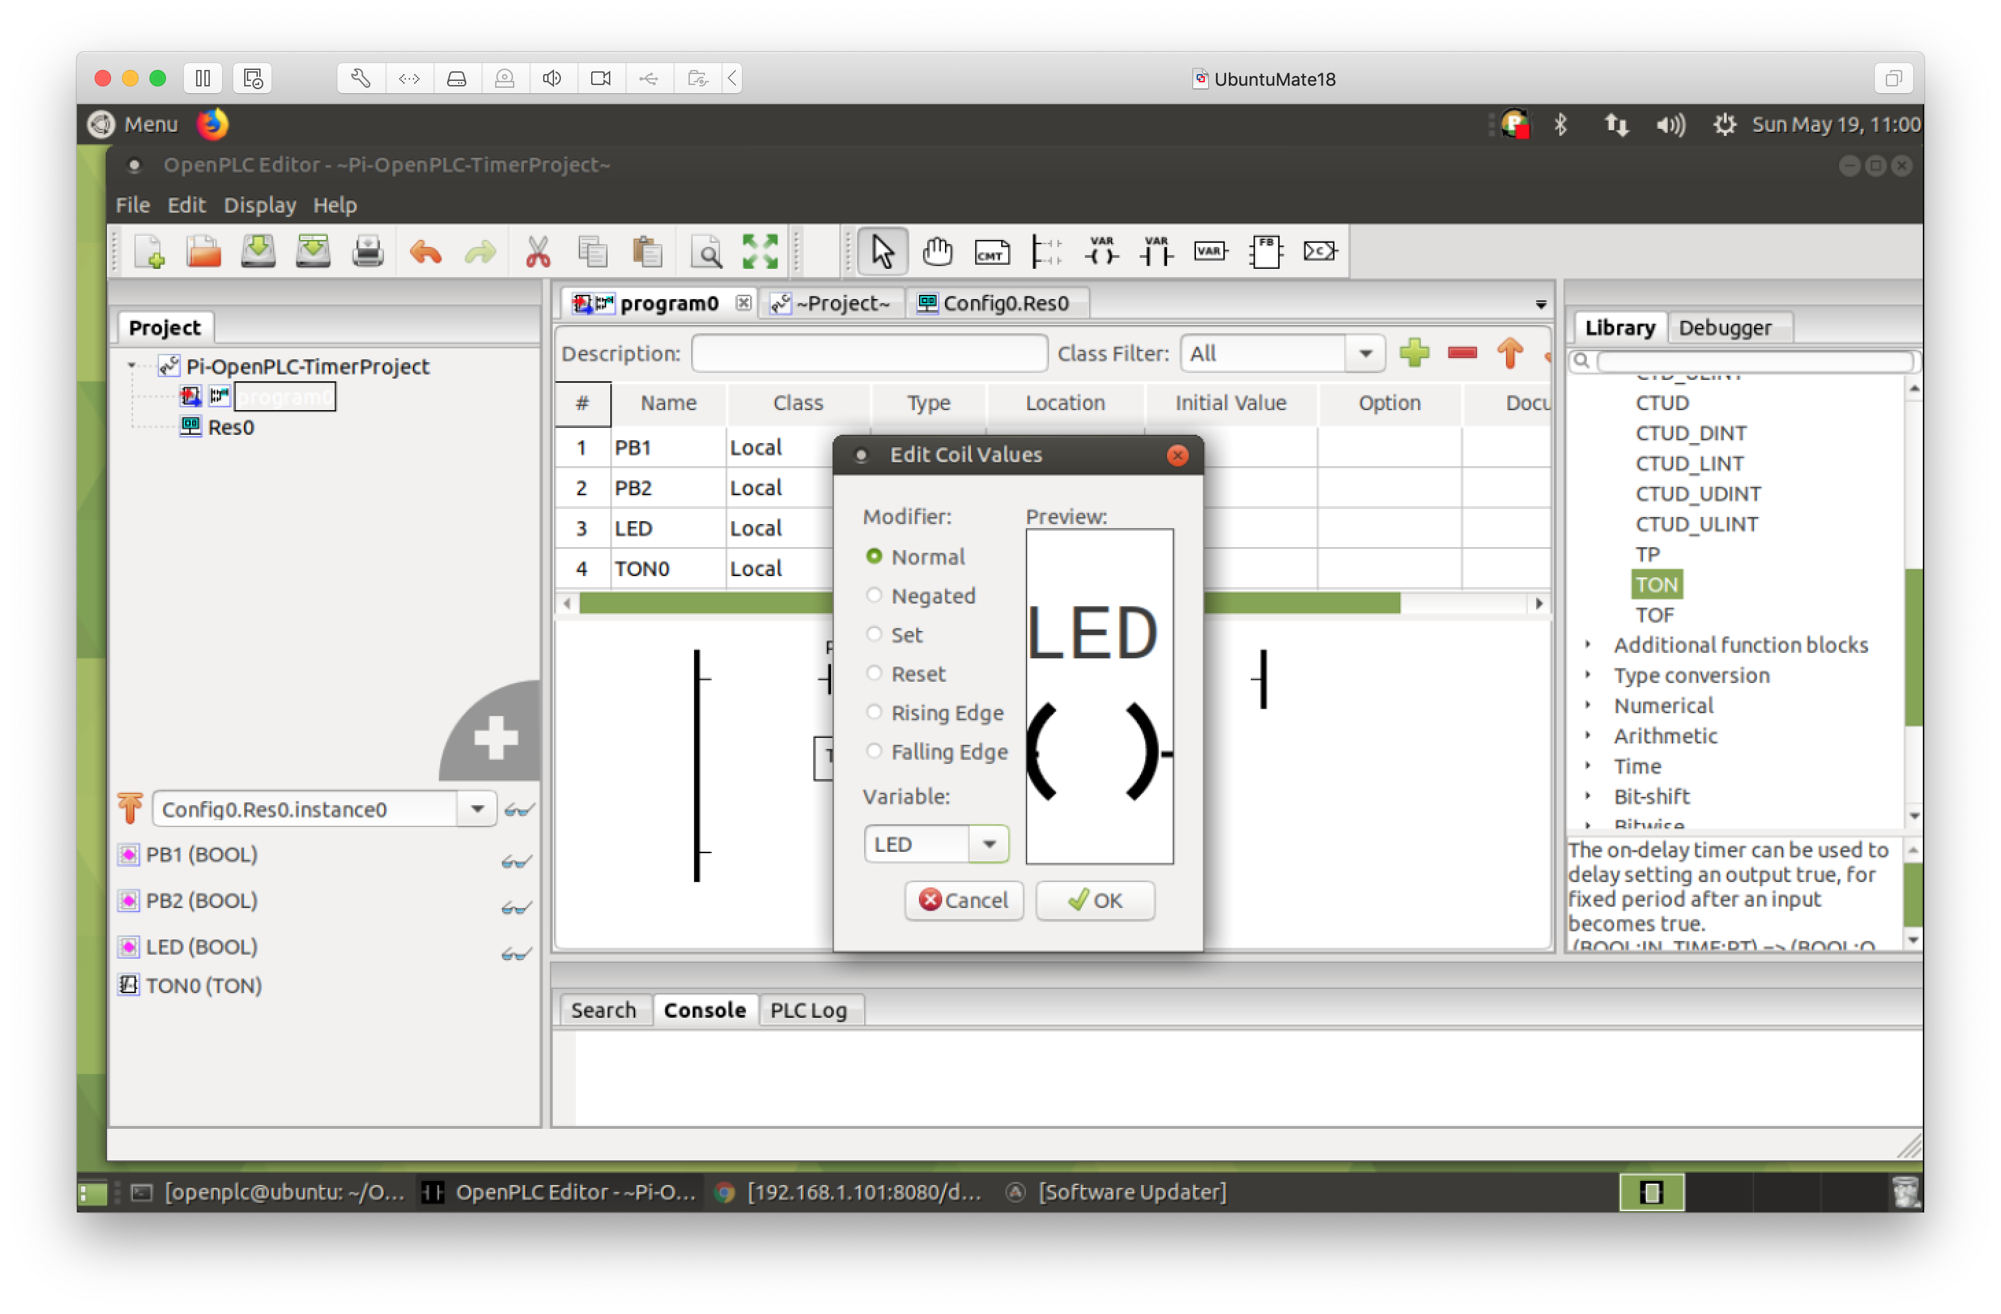

Enter Ladder Logic - 11
1. Add LED output coil
2. Click and drag to define wire connections

Slide 33
Suggested Reading
The OpenPLC Project
https://www.openplcproject.com/
Tommy Morris – Six SCADA Modules
https://clark.center/details/tommy_morris/Six%20SCADA%20Modules

Slide 34
Hands-On Laboratory Exercise #1

Slide 35
Laboratory Exercise #1 Instructions - 1
Objective
Learn how to use OpenPLC Editor to create a program using Ladder Logic

Slide 36
Laboratory Exercise #1 Instructions - 2
Install OpenPLC Editor
Use OpenPLC Editor to enter the Ladder Logic for the First Project as described at the URL
https://www.openplcproject.com/reference-your-first-project
Adjust the Input/Output pin locations to match those on the OpenPLC slave Arduino Uno
Be sure to save your work
https://www.openplcproject.com/reference-your-first-project

Slide 37
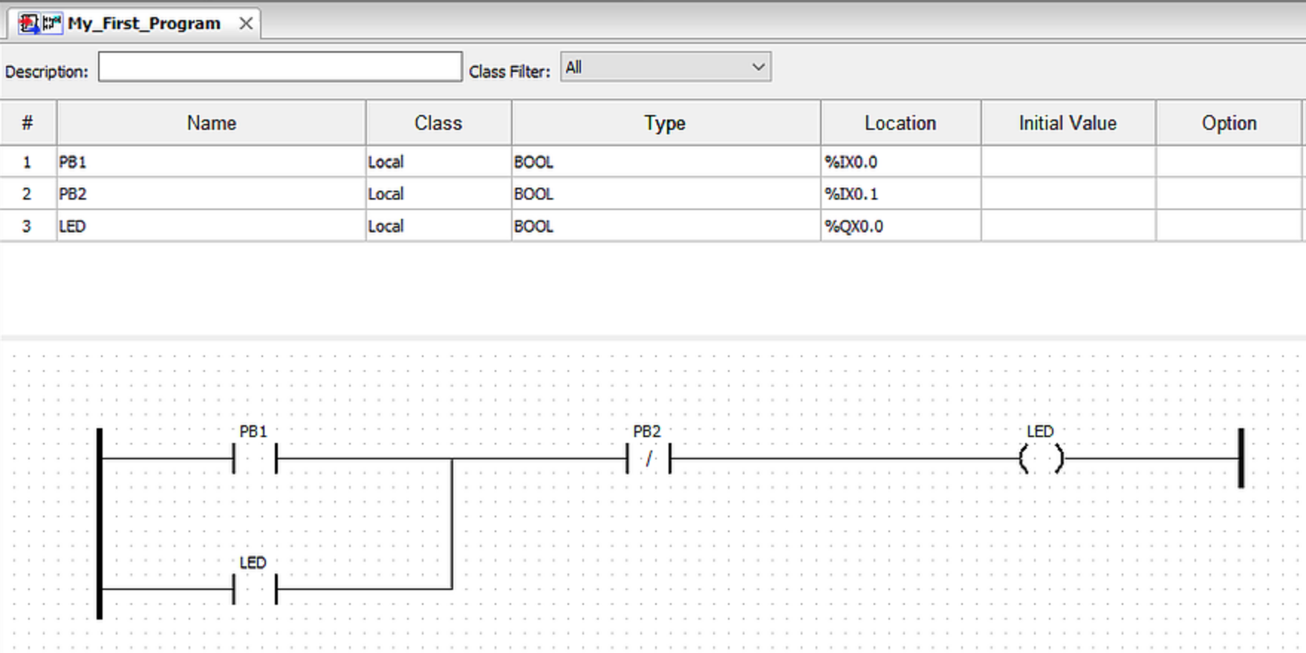
Laboratory Exercise #1 Instructions - 3
Adjust these to match Arduino Uno OpenPLC slave
https://www.openplcproject.com/reference-your-first-project

Slide 38
Laboratory Exercise #1 Instructions - 4
Sample Deliverables
Zip file of entire project folder
Screenshots of Ladder Logic program

